Slide 1
© 2015 American Nurses Association

Slide 2
Provisions 7-9, Commitment Beyond Individual Patient Encounters
Slide Deck 3
© 2015 American Nurses Association

Slide 3
Provisions 7-9, Commitment Beyond Individual Patient Encounters
What do we mean by “commitment beyond individual patient encounters”?
Provisions 7-9 focus on the expanded duties of the nurse and the nursing profession in advancing nursing and health care nationally and globally.

Slide 4
The nurse, in all roles and settings, advances the profession through research and scholarly inquiry, professional standards development, and the generation of both nursing and health policy.
Interpretive Statements
7.1 Contributions Through Research and Scholarly Inquiry
7.2 Contributions Through Developing, Maintaining, and Implementing Professional Practice Standards
7.3 Contributions Through Nursing and Health Policy Development
Provision 7

Slide 5
7.1 Contributions Through Research and Scholarly Inquiry
Knowledge development advancing the body of nursing science.
All nurses engage in scholarly activity by providing evidence-informed practice.
Nurse researchers follow national/international standards for conducting research with human participants.
All research must be approved by institutional review boards (IRBs) in compliance with national standards.
Patient welfare must never be jeopardized for research findings.

Slide 6
Vulnerable Populations
Do not generally have access to government or private resources to meet basic needs:
Low-income persons
Underserved populations
People with disabilities
Elderly persons
Children
Prisoners
Homeless persons
Mentally ill persons

Slide 7
Questions to Ask About Ethics of Research Studies
Should a study be judged by today’s ethical standards or the standards applied at the time of the study?
Were participants informed and did they comprehend risks?
Did the research knowingly cause harm?
Was harm a direct and foreseen result of the study or of some other factors?
Did experimentation continue after harmful results were known?
Was help available to subjects after the study?
Were results suppressed, falsified or destroyed?

Slide 8

Questions to Ask about Ethics of Research Studies
What are the implications of a research survey of Alzheimer’s patients?
How could informed consent be obtained?
How valid would verbal responses to a survey be?
What steps could be taken to make such a study ethically acceptable and meaningful?

Slide 9
Research With Marginalized Subjects
Research Ethics Committees: Safeguard Dignity, Rights, Safety and Well-being of All Research Participants
Research Ethics Committees: Ensure High-Quality Research That Offers Benefits to Participants, Services and Society
Professionals’ Use of Responsible Advocacy
Nonmaleficence
Beneficence
Right to Information
Paternalism
AVOID:
Exploitation, Coercion and Exclusion and Discrimination
Informs Policy and Service Provision
Informed Consent
Right to Withdraw
Facilitative
Seek Active Involvement of Service Users
Volunteer to Participate
Autonomy
Justice
Notes:
Smith, L. (2008). How ethical is ethical research? Journal of Advanced Nursing, 62(2), 254.
Discussion Question: Note that this relies on ethical principlism. How might an ethic of caring approach these questions? Virtue ethics?

Slide 10
7.2 Contributions through Developing, Maintaining and Implementing Professional Practice Standards
Scope and standards inform practice in multiple specialties and all settings.
Practice environments should facilitate implementation of these standards.
Standards should be woven through any nursing program curriculum.

Slide 11
7.3 Contributions through Nursing and Health Policy Development
Nurses must advocate for health policies through institutional, local, regional, state, and national initiatives to improve quality of life for populations.
Health policy advocacy should be included in nursing curricula.
Nurses are more powerful when their voices are combined through professional organizations.

Slide 12
Provision 8
The nurse collaborates with other health professionals and the public to protect human rights, promote health diplomacy, and reduce health disparities.
Interpretive Statements
8.1 Health Is a Universal Right
8.2 Collaboration for Health, Human Rights, and Health Diplomacy
8.3 Obligation to Advance Health and Human Rights and Reduce Disparities
8.4 Collaboration for Human Rights in Complex, Extreme or Extraordinary Practice Settings

Slide 13
8.1 Health Is a Universal Right
Radical declaration:
Health Is a Universal Right
Creates obligation to advance health and human rights.

Slide 14
8.2 Collaboration for Health, Human Rights, and Health Diplomacy
“If health is a human right, then a health disparity is a human rights issue and the struggle to achieve health equity for all is an issue of social justice.”
-Jacquelyn Miller, CEO, Nebraska DHHS
Notes:
Kosoko-Lasaki, S., Cook, C.T., & O’Brien, R.L. (2008). Chapter 15: Health Disparities: The Nebraska Perspective. In Cultural Proficiency in Addressing Health Disparities. Sudbury, MA: Jones & Bartlett.

Slide 15
“If we could change the health of the world by changing one thing, it would be to ensure equal rights for women.”
-Eleanor Roosevelt
Notes:
Retrieved from http://www.usaid.gov/what-we-do/gender-equality-and-womens-empowerment.

Slide 16
United Nations human rights include…
Highest attainable standard of physical and mental health
  Including reproductive and sexual health
Equal access to adequate health care and services
  Regardless of gender, race, or other status
Equitable distribution of food, safe drinking water and sanitation
Adequate housing, safe workplace
Freedom from discrimination
Education, including health and sex education
Environment appropriate for a child’s physical and mental development
Notes:
Mertas, J. (2009). We can end poverty - Millennium Development Goals and Beyond 2015. The United Nations and Human Rights: A Guide for a New Era (2nd Ed.). New York: Routledge Publishing Company.
ISBN 978-0-415-49132-7

Slide 17
United Nations Millennium Development Goals 2000-2015
Eradicate Extreme Hunger and Poverty
Achieve Universal Primary Education
Promote Gender Equality and Empower Women
Reduce Child Mortality
Improve Maternal Health
Combat HIV/AIDS, Malaria and Other Diseases
Ensure Environmental Sustainability
Develop a Global Partnership for Development
Notes:
Mertas, J. (2009). We can end poverty- Millennium Development Goals and Beyond 2015. The United Nations and Human Rights: A Guide for a New Era (2nd Ed.). New York: Routledge Publishing Company.
ISBN 978-0-415-49132-7
NOTE: United Nations Millennium Development Goals: http://www.unmillenniumproject.org/goals/

Slide 18
United Nations Progress Report
Check out the United Nations Progress Report: www.un.org/millenniumgoals/
Extreme poverty is falling in every region, including Africa
Water sources have improved
Fewer people living in urban slums
More children are in primary school (especially girls)
Deaths under age 5 have fallen
Millions more are receiving HIV antiretroviral therapy
TB deaths are expected to fall dramatically
Malaria cases have decreased

Slide 19
Global Challenges Remain
Global economic crises slowed progress for some countries; unemployment persists
Rural areas haven’t improved water sources enough
Maternal mortality is still too high
Hunger and malnutrition persist
Slums are still growing
Gender inequality and violence undermine efforts of women to reach goals
Notes:
www.un.org/millenniumgoals/

Slide 20
Underserved in Health Care
Power differential exists between those who can access health care and those who cannot
Uninsured, underinsured
    Marginally insured
    Tenuously insured
    Periodically insured
    Refugees and immigrants
Stigma of welfare in America
    Less likely to secure Medicaid benefits
Access to Care Is Still a Huge Issue for Millions

Slide 21
But What Can I Do About These Huge Problems?

Slide 22
Some Small Steps for Individual Nurses
Read to stay informed
Write letters to legislators
Foster healthy lifestyles in your community
Be aware of underlying community conditions contributing to health problems
Create a clinical environment that is culturally sensitive to diverse cultural perspectives
Join a professional organization that lobbies Congress for equitable policies

Slide 23
Your Voice Is Amplified in Professional Organizations
Nursing: American Nurses Association
  Specialty Organizations
Multidisciplinary (Health)
  Public Health, American Public Health Association
  Rural Health
Multidisciplinary/Multiorganizational
  Sociologists, political scientists, demographers
  Environmentalists, journalists, historians, geoscientists, climatologists and more

Slide 24
8.3 Obligation to Advance Health and Human Rights and Reduce Disparities
Collaboration: An Instrument for Social Justice
Inequality, poverty, and stigma erode health
Social determinants of health must be addressed, including…
  Contaminated water and air
  Poor sanitation
  Hunger
  Limited education
  Violence, warfare
  Homelessness

Slide 25
Partnerships
Collaborative partnerships with a united voice can impact legislation, policies, and relief efforts to alleviate suffering and create living conditions in which populations can flourish.

Slide 26
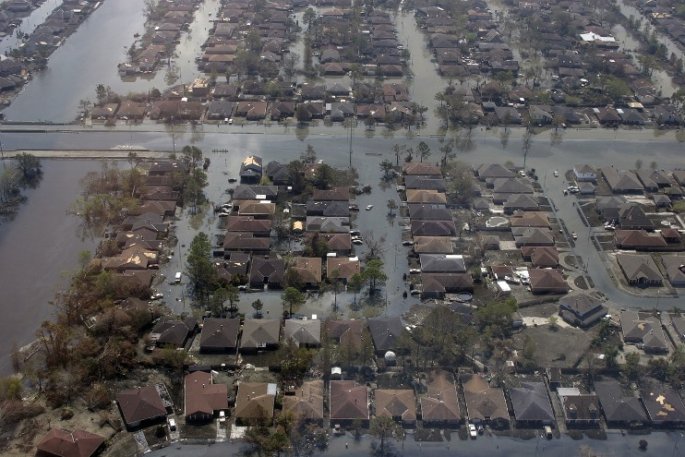
8.4 Collaboration for Human Rights in Complex, Extreme, or Extraordinary Practice Settings

Slide 27
Imagine…
You are the only RN caring for three terminally ill patients in the ICU on the 5th floor during a hurricane that has knocked out power, contaminated the water, and produced structural damage to the hospital.
Evacuation is not possible for four days during which you run out of IVs and morphine. The pharmacy is shut down and all pharmacists have evacuated.
Patients are suffering in 105 degree heat with no fluids and no pain relief. One patient asks you to be merciful and end his suffering. What are your options? What guidance does the Code provide?

Slide 28
Continuum of Vulnerability
When individuals lose power to represent themselves and their needs, wishes, values, and choices, others must advocate for them.
Potentially vulnerable
Circumstantially vulnerable
Temporarily vulnerable
Episodically vulnerable
Permanently vulnerable
Notes:
Blaikie, P., Cannon, T., Davis, I., & Wisner, B. (2014). At risk II natural hazards, people’s vulnerability and disasters (2nd Ed.). New York: Science Division of Rutledge Publishing Company.
ISBN 0-415-25215-6

Slide 29
Provision 9
The profession of nursing, collectively through its professional organizations, must articulate nursing values, maintain the integrity of the profession, and integrate principles of social justice into nursing and health policy.
Interpretive Statements
9.1 Articulation and Assertion of Values
9.2 Integrity of the Profession
9.3 Integrating Social Justice
9.4 Social Justice in Nursing and Health Policy

Slide 30
9.1 Articulation and Assertion of Values
Unified Voice to Assert Shared Values.
Professional organizations articulate and share mutual values with the profession, colleagues, and the public.
Unwavering Central Values
    Promotion or restoration of health
    Prevention of illness and injury
    Alleviation of pain and suffering
Notes:
Ferrell, B.R., & Coyle, N. (2008). The nature of suffering and the goals of nursing. New York: Oxford University Press.

Slide 31
The Perils of Social Change
“All progress is precarious, and the solution of one problem brings us face to face with another.”
-Martin Luther King Jr., 1963
“Be not afraid of going slowly, be afraid only of standing still.”
-Ancient Chinese Proverb
“Make haste, but do it cautiously.”
-Marge Hegge
Notes:
Martin Luther King Jr. quote from Orlando Sentinel. Retrieved from http://www.orlandosentinel.com/entertainment/os-martin-luther-king-jr-quotes-story.html#page=1

Slide 32
9.2 Integrity of the Profession
Encouraging respect, fairness, and caring in all facets of nursing
Ensuring nursing workforce sustainability
Fostering higher education of nurses
Advancing nursing science
Supporting certification and licensure
Facilitating evidence-informed practice

Slide 33
9.3 Integrating Social Justice
Vigilance to influence those in power to:
Improve health and health care
Address unjust systems and structures
Address underlying determinants of health
Redress wrongs

Slide 34
Creating the Landing Strip to the Future
“In today’s turbulent times, engaging people’s best thinking about complex issues without easy answers will be the key to creating the futures we want rather than the futures we get.”
  -Eric Vogt, The Art of Powerful Questions
Notes:
Vogt, E., Brown, J., & Isaacs, D. (2003). The art of powerful questions: Catalyzing insight, innovation and action. Mill Valley, CA: Whole Systems Association.
ISBN 0-9724716-1-8
Quoted in American Leadership Forum. (2012) Common Ground/Common Good. Silicon Valley, CA: Author. P. 38.

Slide 35
9.4 Social Justice in Nursing and Health Policy
Open and honest communication
Work in concert to advance common good
Environmental restoration

Slide 36
Global Burden of Disease
(World Health Organization)
Africa,
Southeast Asia
Are Poorest Nations
30 Richest Nations
Population Disease Health $ Providers
Population Disease Health $ Providers
Notes:
World Health Organization. Retrieved from www.worldhealth.org
World’s biggest killers: pneumonia, diarrheal diseases, followed by AIDS, TB and Malaria, all rampant in Tanzania.

Slide 37
  Global Health Inequities
  Less than 10% of the world’s health research budget is spent on conditions that account for 90% of the world’s diseases!
Notes:
Doyle, L. (2004). Gender and the 10/90 gap in health research. Bulletin of the World Health Organization, 82(3). Retrieved from http://www.who.int/bulletin/volumes/82/3/162.pdf
Research does not reflect global disease burden, they reflect purchasing power!
In Rich countries, 1/10 deaths are due to infections, due to drugs/vaccines. In Poor countries 6/10 deaths are due to infections. Half of these could be prevented.

Slide 38

World Health
Americans can no longer isolate themselves from epidemics and pandemics in faraway places.
We all share this fragile small planet, and share risk of infectious diseases fanning across the globe.
Notes:
Doyle, L. (2004). Gender and the 10/90 gap in health research. Bulletin of the World Health
Organization, 82(3). Retrieved from http://www.who.int/bulletin/volumes/82/3/162.pdf
Research does not reflect global disease burden, it reflects purchasing power!
In rich countries, 1/10 deaths are due to infections, due to drugs/vaccines. In poor
countries 6/10 deaths are due to infections. Half of these could be prevented.
Not a quote, just an observation.

Slide 39

Global Injustice
How are we to respond?
Notes:
The poor bear the brunt of dangerous environmental toxins, contaminated water, poor nutrition, lack of education, warfare, violence, and homelessness. The poor are the least able to deal with these hazards. How is this just?

Slide 40
“Even if you’re on the right track, you’ll get run over if you just sit there.”
-Will Rogers
Notes:
Retrieved from http://philosiblog.com/2011/06/28/even-if-you%E2%80%99re-on-the-right-track/.

Slide 41
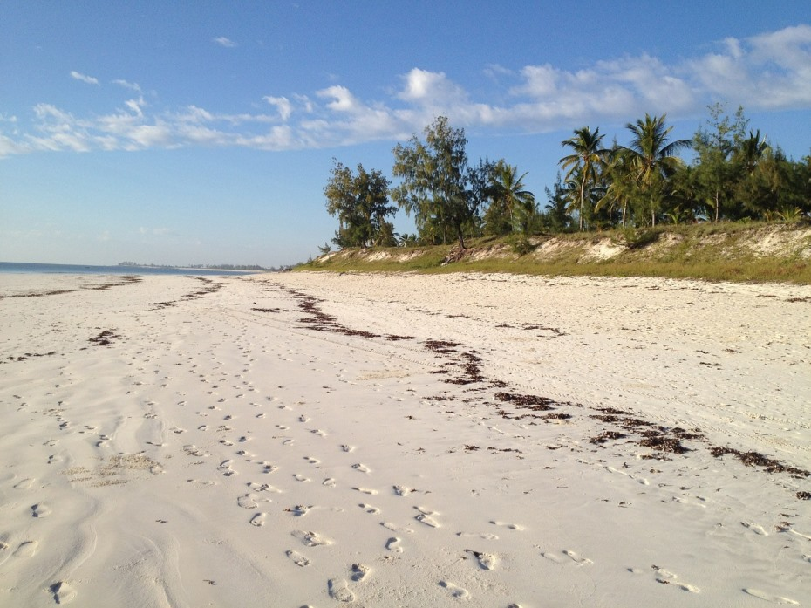
“Nurses are messengers of hope for
troubled times. Leave your footprints of hope
for the next generation to follow.”
-Marge Hegge
Notes:
Quote from Marge Hegge, January 21, 2015, ANA’s Webinar on Code of Ethics.

